Slide 1
[Skills Bootcamp for Data Analytics Portfolio]
[Ameena Hamid]

Slide 2
Introduction
Ameena Hamid
I enrolled on the Skills Bootcamp for Data Analytics as I had an interest in Data Analysis, arising from my background as an analytical scientist. As my knowlege was only to a basic level of Microsoft Excel, I was keen to learn advanced skills in programmingn such as Python. My final goal after completion of this course is to pursue a career in Data Analysis.

Slide 3
[Early Stage Diabetes Risk Prediction Dataset ]
Ameena Hamid
One of the datasets I have decided to analyse for my portfolio has a theme of health, as this relates to my background in science. The dataset I have selected consists of data for the key signs and symptom of people who are either at risk of developing diabetes and are showing early signs/symptoms of the disease have tested positive.
Can we predict an onset of Diabetes from the symptoms an individual is showing?

Slide 4
Early Stage Diabetes Risk Prediction Dataset - What does the data look like?
Ameena Hamid
Data for 520 individuals of a varied age range
14 different symptoms of a possible diabetes patient
Data shows which symptom is present/not present for each individual
Class confirms if an individual is positive or negative for Diabetes

Slide 5
Early Stage Diabetes Risk Prediction Dataset - Exploratory data analysis
Ameena Hamid
The link below shows the Jupyter Notebook with the exploratory data analysis and code
https://anaconda.cloud/share/notebooks/496e882b-39f1-4e71-98d4-ef32a37aa94a/overview

Slide 6
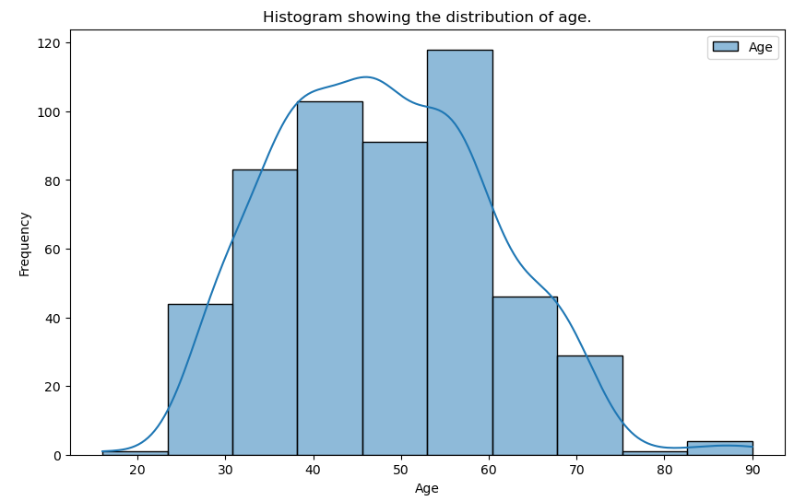
Early Stage Diabetes Risk Prediction Dataset - Data Visualization
Ameena Hamid
The Histogram is showing a fairly normal distribution of ages, with a bell-shaped curve
We can see a cluster of individuals between 40-60
The mean, median and mode of the data are also similar, signifying a normal distribution (see Jupyter notebook)
Notes:
Is there a trend where the older you are, the more likely you are to be on the onset of diabetes?

Slide 7
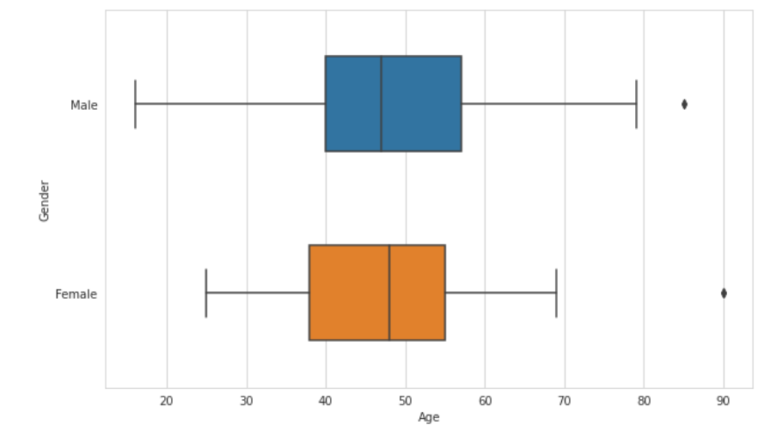
Early Stage Diabetes Risk Prediction Dataset - Data Visualization
Ameena Hamid
The Box plot is showing the distribution of ages for each Gender in more detail
The visualisation shows that the age range for Male individuals is right skewed and for Female individuals is left skewed.
The middle 50% of the data for Males lies between 40 - 57 and for Females lies between 37 - 55
Are females more likely to be diagnosed with diabetes at a younger age than males?

Slide 8
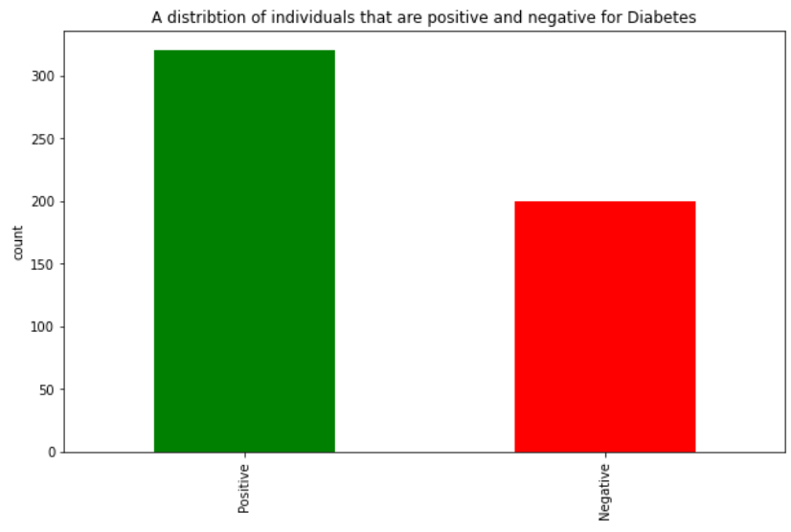
Early Stage Diabetes Risk Prediction Dataset - Data Visualization
Ameena Hamid
The number of people positive for Diabetes are significantly higher than those that were negative but may still have had some of the symptoms

Slide 9
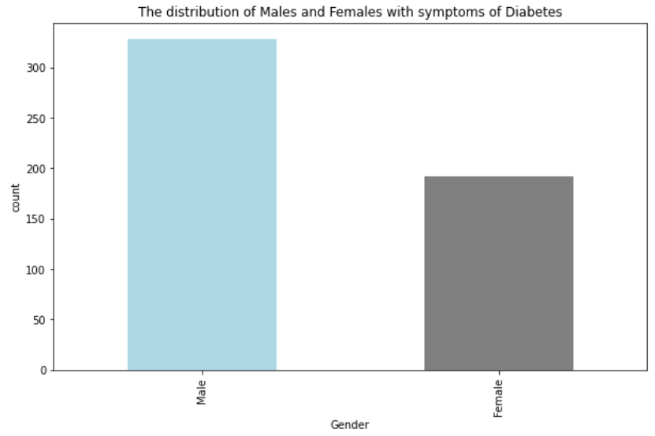
Early Stage Diabetes Risk Prediction Dataset - Data Visualization
Ameena Hamid
From this visualization we can see that the number of males with symptoms of diabetes is almsot 50% more than females with the symptoms
Can we do further research to see why this could be a possibility?

Slide 10
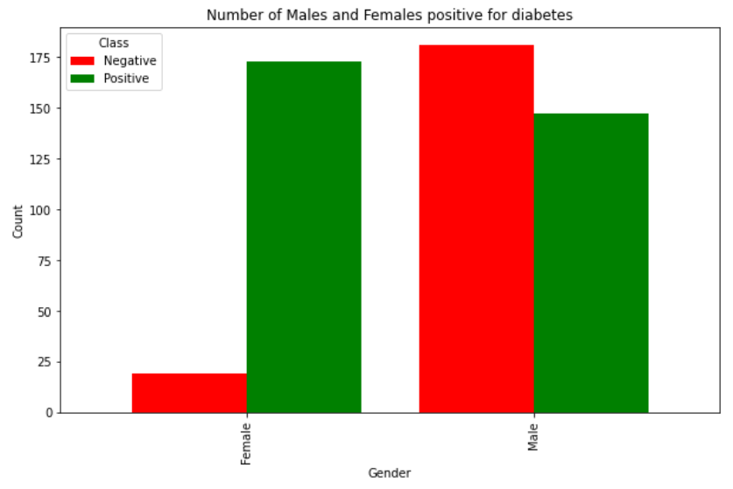
Early Stage Diabetes Risk Prediction Dataset - Data Visualization
Ameena Hamid
Further analysis shows that the number of Females positive for Diabetes is slightly higher than the number of Males that are positive.
The number of females that are negative for Diabetes but may be displaying symptoms are significantly lower than the number of males that are positive
However, the number of females overall with symptoms are also considerably lower than males

Slide 11
Early Stage Diabetes Risk Prediction Dataset - Data Visualization
Ameena Hamid
Further analysis shows that the number of Females positive for Diabetes is slightly higher than the number of Males that are positive.
The number of females that are negative for Diabetes but may be displaying symptoms are significantly lower than the number of males that are positive
However, the number of females overall with symptoms are also considerably lower than males

Slide 12
Early Stage Diabetes Risk Prediction Dataset - Summary
Ameena Hamid
The typical age range for individuals with symptoms of diabetes or on the onset of diabetes is between 30-60
Males are more prone to diabetes than females
Females may be diagnosed with diabetes at a younger age than Males
Do we need look at data that has an equal number of females to males ratio for a more accurate analysis?

